Slide 1
A
B
C
D
=
+
E
=
+
Figure: Transposable Elements in Single-Event Structural Variants
A. Distribution of TE content in seSVs based on their frequency of presence. Normalization is done relative to the number of seSVs that contain at least some TE content. The pie chart shows the distribution of the absolute number of seSV categories.
Supplementary Figure2 - A. Distribution of absolute numbers of seSVs across different TE content categories, based on their frequency of presence.
Supplementary Figure2 - B. Length distribution of seSVs in different TE content categories. The "complete TE" category shows a noticeable increase of SVs at around 5kbp in length. A similar trend can be observed in the "contains complete" and "contains fragment" categories, suggesting that TE annotations should likely be corrected. The distribution of "no TE" seSVs also shows a slight increase in abundance at 5kbp, implying the presence of new, unknown TEs.
B. Uneven distribution of TE families' presence in seSVs of different TE content categories.
Values are normalized by rows; only values higher than 0.2 are shown, transparency reflect the fraction (the higher the value, the darker the color).
Grey horizontal bars reflect the absolute number of seSVs for each family.
Supplementary Figure2 C-F. Normalized distributions of TE-family content in SVs according to the frequency of presence for each category of TE content. These distributions are visually different.
Supplementary Figure2 G. To support that that distributions in [C-F] are different, all columns in these subplots were taken as observations, and the PCA plot was constructed. The first principal component described the difference between categories of TE content based on their TE-family content, supporting the difference in TE-family content in seSVs from different TE-categories.
C. Non-uniqueness of seSV in different TE content categories. "In graph" category meants that the SV was connected to any other SV by the nextendess relation. Almost all seSV which are "complete TE" were connected by come other SV, however around 75% of seSVs without TE content were unique.
Supplementary Figure3 A. Scheme of idea, how graph of nestedness was constructe.
D. Graph illustrating the nestedness of seSVs, considering only SEs with non-zero TE content. Similarity threshold 0.85.
Each node represents a set of mutually nested SVs. The size reflects the relative number of SVs in the node.
This graph has one large connected component and numerous smaller ones. The decomposition is displayed as a sum of the largest connected component with a cloud of the remaining components shown on the right-hand side of the equality sign.
Supplementary Figure2 B-D. Example of a small commented component.
E. The same graph as in [D], but colored by TE families.

Slide 2
A
D
is complete TE
is TE fragment
contains complete TE
contains TE fragment
no TE
B
=
+
C
=
+

Slide 3
Supplementary Figure 2
A
B
C
D
E
F
G
H
I

Slide 4
A
is complete
is fragment
contains complete
contains fragment
B
C
D

Slide 5
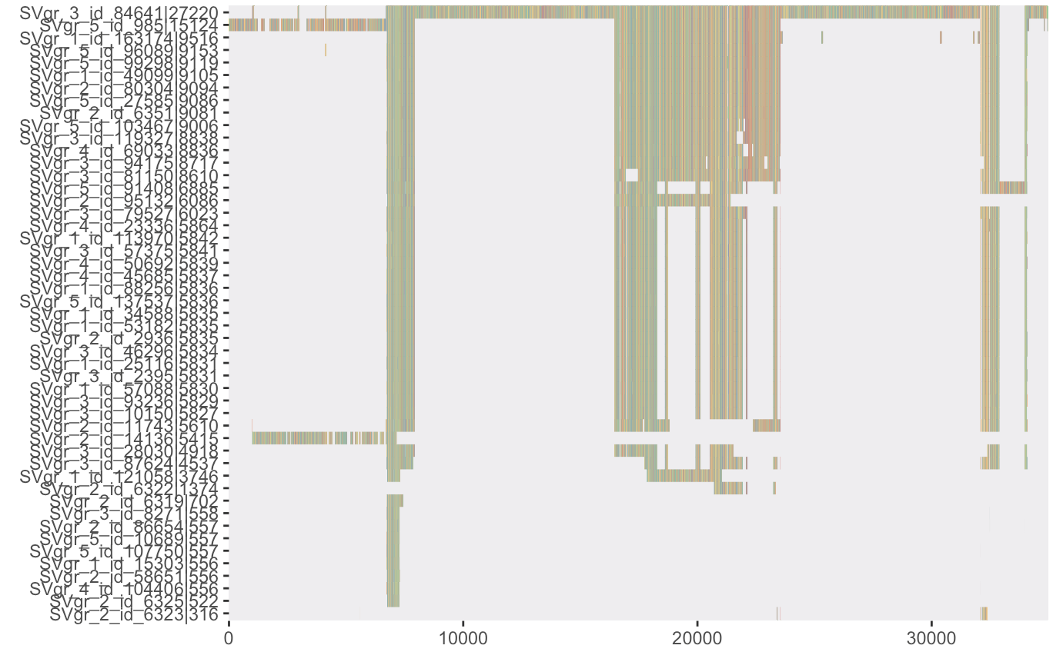

Supplementary Figure 3
A
1
1
1
C
2
3
4
3
2
3
2
5
4
5
4
5
B
21
Insetion(1-3)
Deletion(25-27)
..
36
32
52

Slide 6
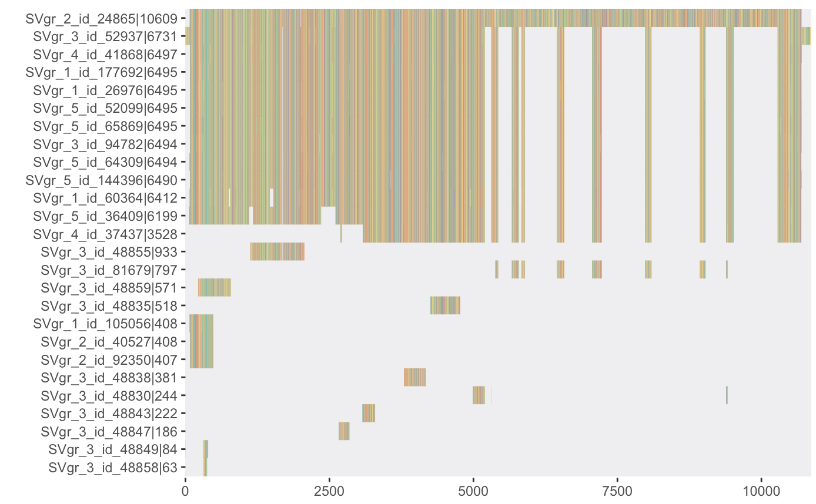
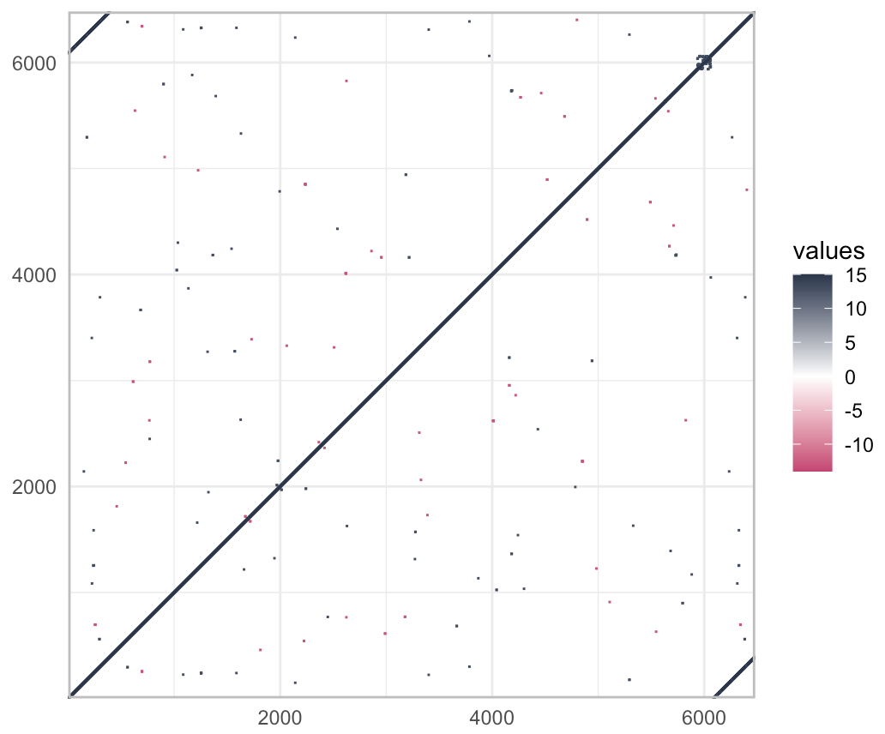
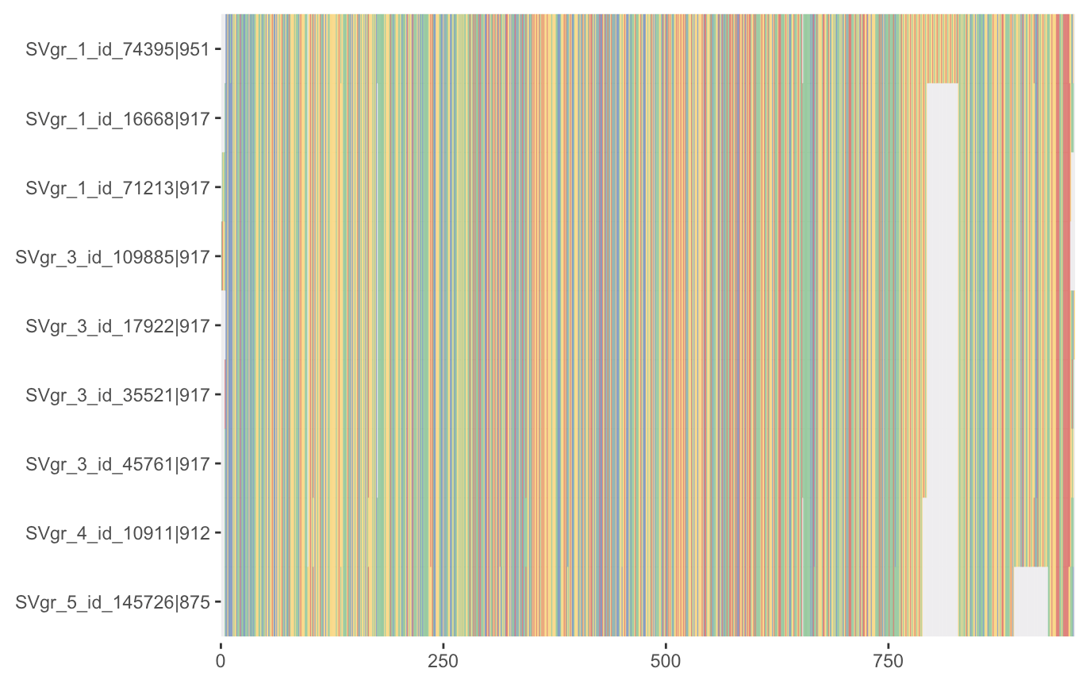
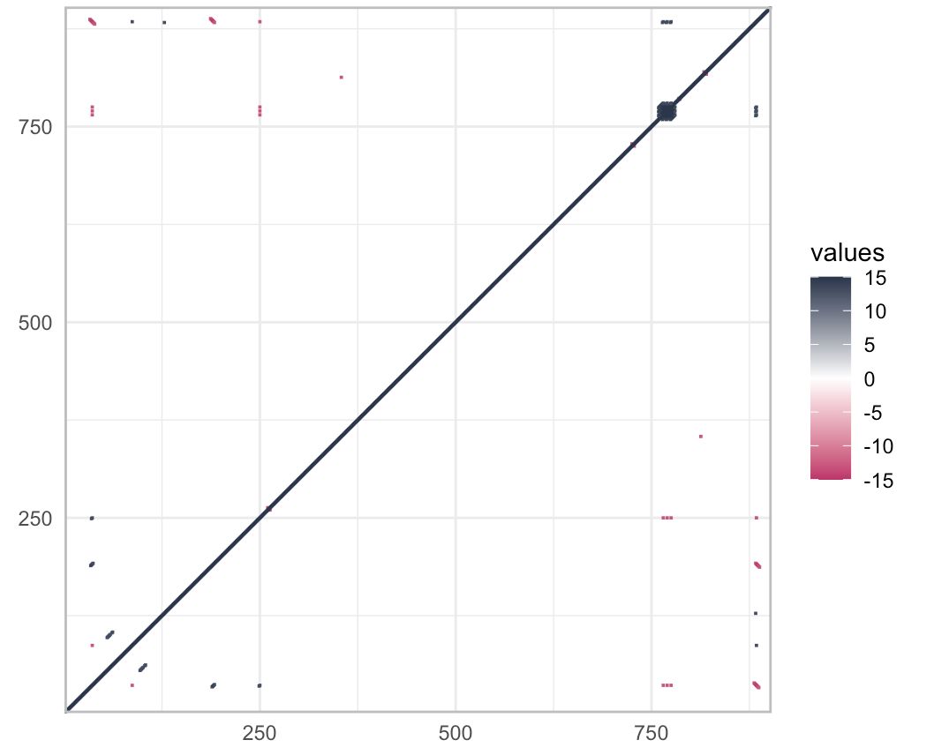
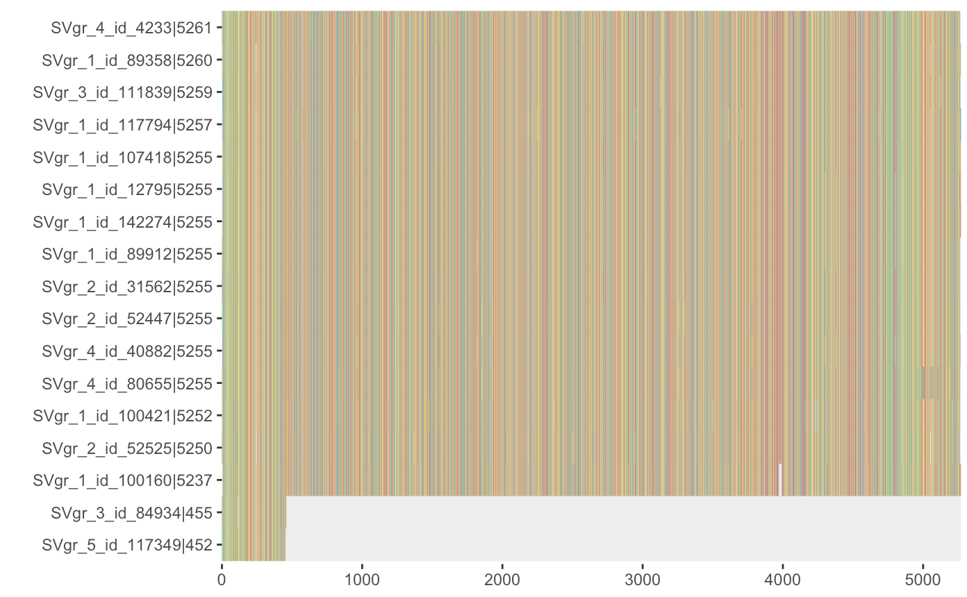


+annotation
113

Slide 7
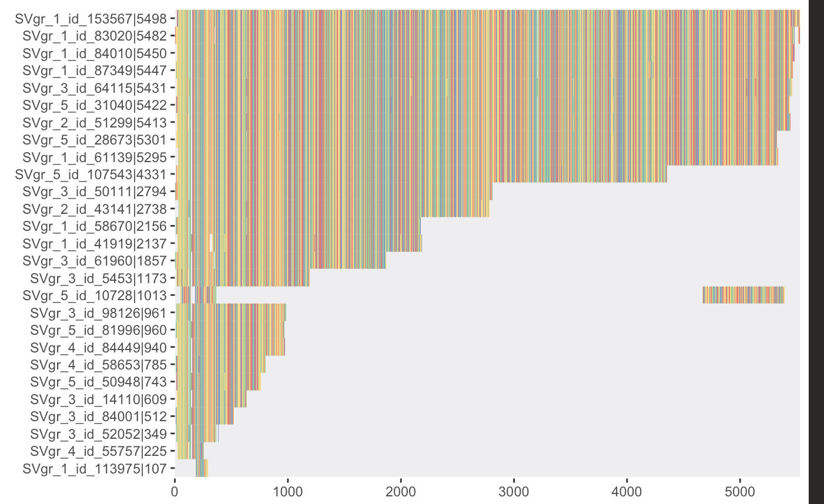

Slide 8
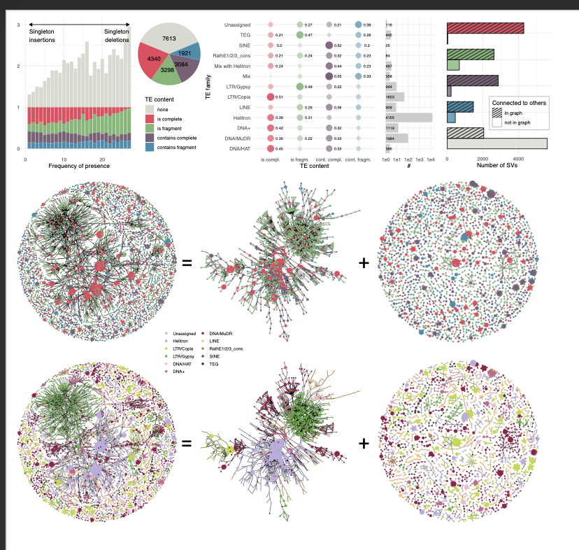







Slide 9
Real TEs story: not all annotated TEs are TEs. Many small sequences are fragments or repeats, which even BLASt doesn’t want to catch.
If they are in the graph of nestedness – they are relatively long.

